Slide 1
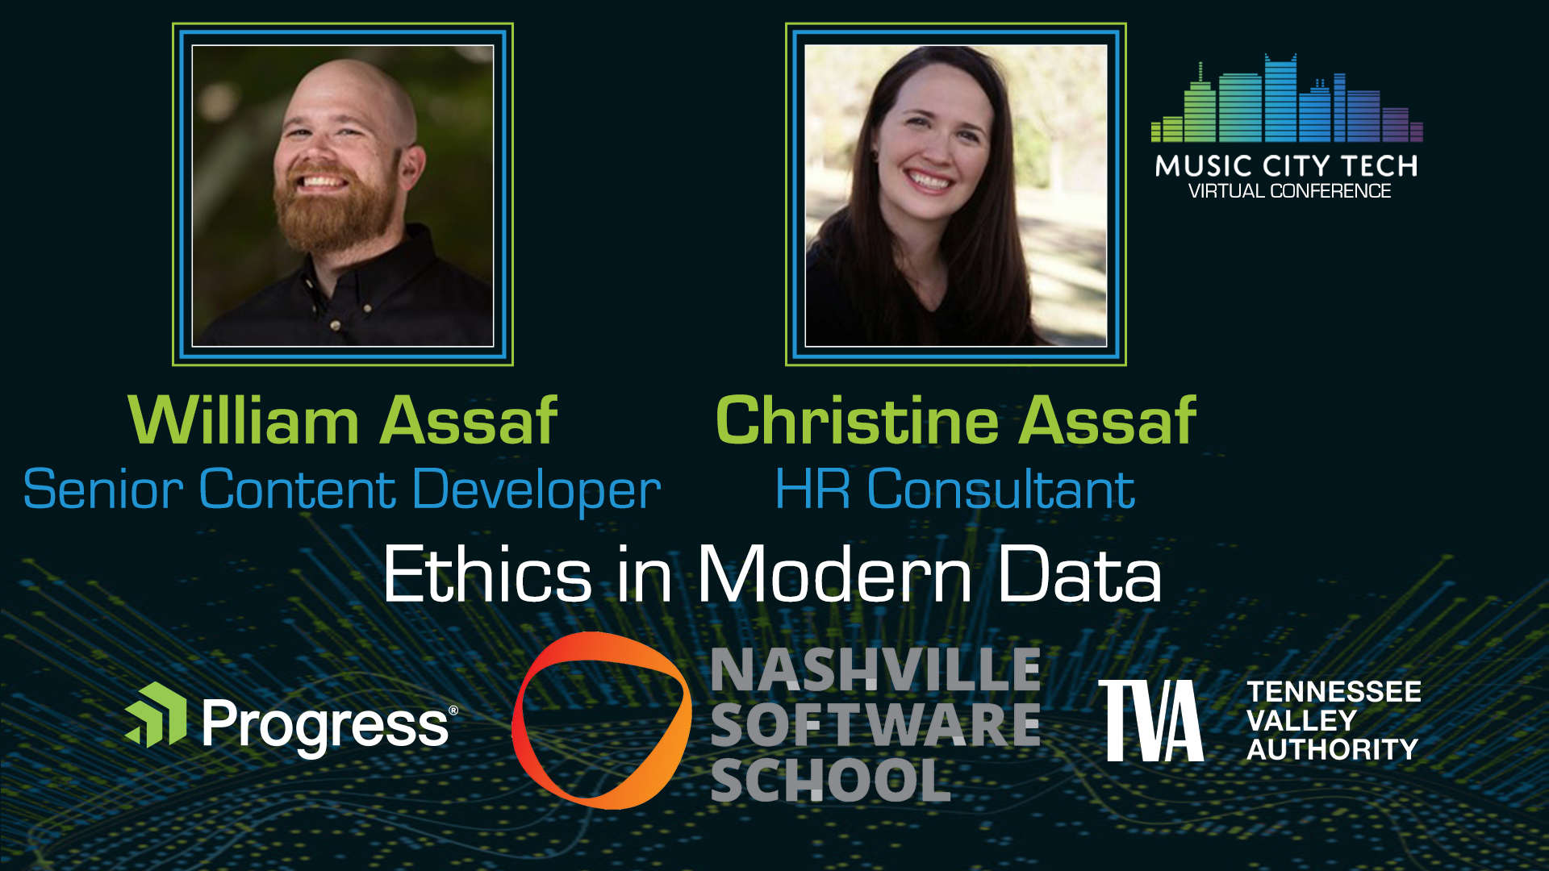

Slide 2


Christine Assaf
Human Resources
Leadership Development, Organizational Development, People Strategies, Training & Development
I/O Psychology
Current grad student; The study of behavior of individuals and groups in the workplace to determine how to improve performance and productivity
HR Consultant
HRTact.com
/christineassaf
Speaker/Trainer/Writer
@hrtact
Communication, Management, Leadership, Team Building, and more

Slide 3

William Assaf
Microsoft Data Platform Expert
Author of SQL Server certification exams, Previously Principal Consultant, DBA Manager, former Microsoft Data Platform MVP
Author, SQL Server Inside Out
Lead of author team for Microsoft Press SQL Server Inside Out 2017 and 2019.
Senior Content Developer, SQL Microsoft
Former PASS Regional Mentor
SQLTact.com
Past organizer of SQL Saturday Baton Rouge, Baton Rouge SQL Server User Group.
/williamdassaf
@william_a_dba
Notes:
Last year I joined the Microsoft SQL Docs team after 13 or so years as a data platform consultant and technical lead.
Worth noting that while we have citations throughout our presentation any opinions are our own alone.
**Questions?** If you have any questions, go ahead and submit them any time, and we’ll save time to answer collected questions and at the end.

Slide 4
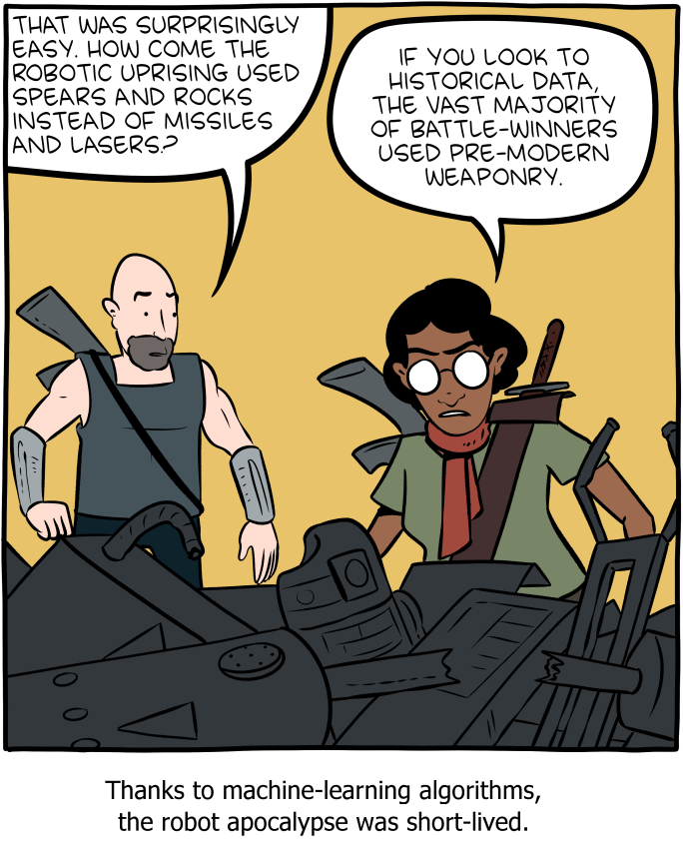
Historical Bias
Image: https://www.smbc-comics.com/comic/rise-of-the-machines
Notes:
WILLIAM
Today we are going to be talking about bias in data analytics and data collection,
what we can to do recognize our own bias and fight the perception of bias,
and on how bias in data has real impacts in our society.
But without context, without understanding historical or time-based biases, both we and our data findings are doomed to parrot bias.
We understand this is an international audience, so one thing to keep in mind is that we are from the United States, born and raised in the South but now living in the Seattle area. Many but not all of our examples are based on United States history. We will try to be as expository as possible when setting the context here, but if you have any questions, we are open to requests for clarification or questions at the end of the presentation. We also have already made this slides available, and you’ll find references to our sources at the bottoms of each slide.
And this is one of my favorite web comic series, Saturday Morning Breakfast Cereal, with a take on why the robot uprising used spears and rocks.

Slide 5
Bias
Notes:
C
If trained on data which contains human bias, then of course our data outcomes will learn bias.
Worse, they are likely to amplify it, institutionalize it, and mask it in the trustworthiness of an “algorithm.”

Slide 6
Bias
“Bias is an inaccuracy which is systematically incorrect in the same direction.
Many algorithms which are trained to do a human job will have been trained on human generated data … This is a huge problem, especially if people assume that algorithms are impartial and can’t hold the same biases as people do.”¹ - Laura Douglas
¹ https://medium.com/@laurahelendouglas/ai-is-not-just-learning-our-biases-it-is-amplifying-them-4d0dee75931d
Notes:
C
Laura Douglas an AI researcher defines bias as… <read quote>
This presentation is about acknowledging both the public’s perception of the trustworthiness of statistical analysis, and also our responsibilities as data professionals, developers, analysts.
This presentation is about our ethical responsibilities as data professionals to become aware of bias, acknowledge it, and be accountable for it.

Slide 7
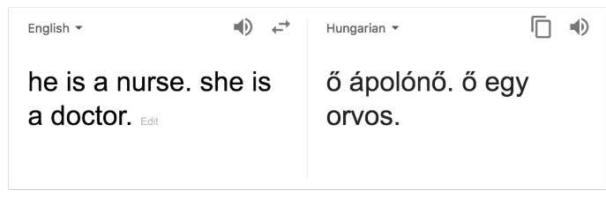
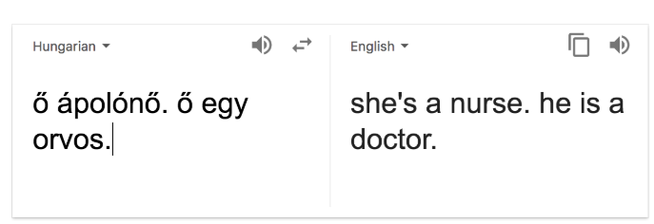
Bias
https://medium.com/@laurahelendouglas/ai-is-not-just-learning-our-biases-it-is-amplifying-them-4d0dee75931d
Notes:
C
Here’s an example of bias… This is from Google Translate.
See here he is a nurse, she is a doctor,
<animation>
but reverse the translation, and the gendered language is reversed, and gender norms are enforced.
<animation>
Biases are “live on display” in the wild. Try it yourself with a number of languages, this works for Hungarian and Turkish to English.
This is only helping to further society’s implicit biases, in this case, on gender norms in professions.

Slide 8
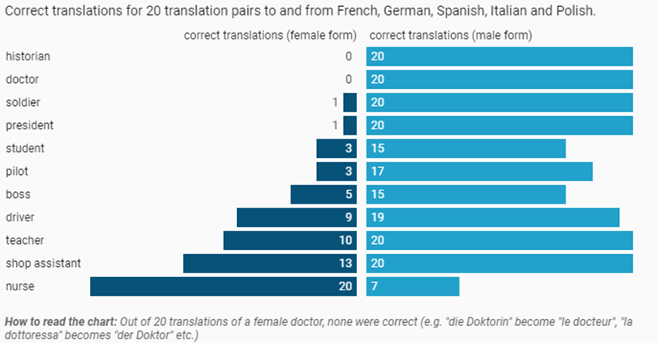
Gender Bias in Translation
Source: AlgorithmWatch Get the data
Notes:
C
In fact, in translations to and from many European languages, the concept of a female doctor or historian is unknown to Google Translate.
Out of 20 translations of a female doctor, none were correct.
And out of 20 references to a male nurse, only 7 were correctly translated.

Slide 9
Historical Bias
Without awareness of historical bias in source data, you will present unethical findings at best.
Bias exists. It must be identified and acknowledged.
Let’s look at a few examples…
Notes:
C
<read notes> Without examining your data for bias, and developing awareness of historical bias in source data, you will present unethical findings - at best.
Bias exists. It must be identified and acknowledged.
Conclusions drawn based on biased data, without caveats, statistical controls, and historical context, may be highly unethical.
<animation>
Let’s look at some more examples of that…

Slide 10
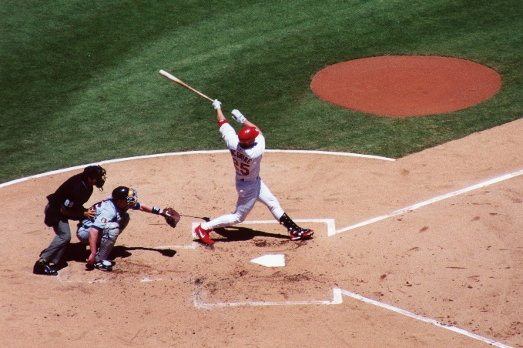
MLB’s Steroid Era
Widespread use of steroids in the late 1990’s and early 2000’s set many new home run records.¹
“There was a significant increase in players who hit more than 40 HR in a single season during the steroid era compared to before and after.”²
¹ https://bleacherreport.com/articles/480826-the-steroid-eras-destruction-of-major-league-baseball
² https://www.omicsonline.org/open-access/the-effect-of-the-steroid-era-on-major-league-baseball-hitters-did-it-enhance-hitting-2161-0673-1000161.php?aid=53354
³ http://www.espn.com/mlb/topics/_/page/the-steroids-era
Image: https://en.wikipedia.org/wiki/Mark_McGwire#/media/File:Mark_mcgwire.jpg
Notes:
WILLIAM
This discusses Major League Baseball in North America.
<read slide>
“Though steroids have been banned in MLB since 1991, the league did not implement leaguewide PED testing until 2003.”³
The top 6 HR single seasons in history were all between 1998-2001, all by three players, Barry Bonds, Mark McGwire, Sammy Sosa.
This knowledge of their illegal actions, affects our historical analysis of:
training techniques,
scouting,
coaching,
Hall of Fame eligibility,
long-term player health,
player compensation,
or stadium batting statistics
We must ethically consider the illegal player behavior during the legal and unmonitored steroid use era in baseball.
OK, that was a soft ball, let’s dive into a more difficult subject.

Slide 11
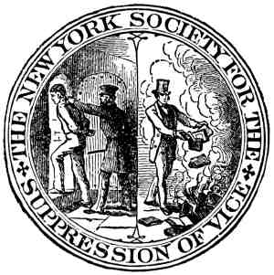
Censorship
U.S. Comstock Law (1873-1957) banned “obscene, lewd, or lascivious” materials.
Mid-20th century libraries experienced “cultural censorship of: racism, sexism, nudity, religion, and evolution.”²
The 1980s ushered in a new push to libraries, school boards, and government agencies to censor books.¹
“Media almost invariably yield to pressure… and establish some sort of code of self-regulation.”³
¹ https://lithub.com/the-history-and-present-of-banning-books-in-america/ ² https://journals.sagepub.com/doi/pdf/10.1080/03064228808534489
³ https://scholarship.law.wm.edu/cgi/viewcontent.cgi?article=1897&context=wmlr ⁴ Tebbel, John William. 1975. “A Brief History of American Bookselling.”
Image: Public Domain due to age
Notes:
WILLIAM
In the United States, the Comstock Laws in effect from 1873-1957 had a widespread and lasting cultural impact, banning “obscene, lewd, or lascivious” materials.
<next>
Mid-20th century libraries experienced “cultural censorship of: racism, sexism, nudity, religion, and evolution.”² In fact the American Library Association in 1984 “discerned a 'continuing pattern' of suppression of information” from the government.²
<next>
The 1980s the Reagan Era ushered in a new push to libraries, school boards, and government agencies to censor books.¹
<next>
And the “media almost invariably yield to pressure… and establish some sort of code of self-regulation.”³ and a sense of self-preservation.
This knowledge affects our analysis of book publication/sales, readership, popularity, public sentiment and sociological trends, even trademark conversations must be aware of “censorship placed on the industry from religious groups, patriots, unions, private businesses…”⁴, and of course the government. Just because publications weren’t sold or available, doesn’t mean the publications didn’t exist, or that there wasn’t public interest in them.
By the way, the Comstock laws also prohibited the mailing and sale of contraceptives, and it was not until 1972 that the United States Supreme Court legalized birth control for all citizens, irrespective of marital status.
This knowledge affects our historical data sources on all sorts of data on American
birth rates,
reproductive health history,
family planning choices,
family size preference,
foreign aid,
and public health policy.

Slide 12
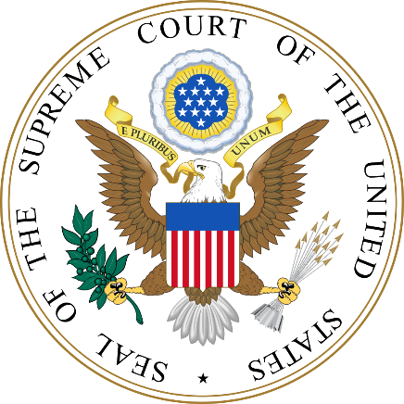
Bias in Judicial Sentencing
A 1992 review in the United States revealed “both ethnic and gender biases in sentencing where judges have discretion, but no biases where discretion is limited.”¹
Sentences for Black males in the U.S. federal system are nearly 20 percent longer than those for white males convicted of similar crimes.²
¹ https://onlinelibrary.wiley.com/doi/pdf/10.1002/bsl.2370100205
² https://www.aclu.org/sites/default/files/assets/141027_iachr_racial_disparities_aclu_submission_0.pdf
Image: public domain
Notes:
WILLIAM
<read notes>
There is significant, historical and modern day evidence for race-based bias in federal judicial sentencing.
A 1992 review revealed “both ethnic and gender biases in sentencing where judges have discretion, but no biases where discretion is limited.”¹ Another study in 2014 found that sentences for Black males in the federal system are nearly 20 percent longer than those for white males convicted of similar crimes.²
The data speaks to two different potential causes.

Slide 13
Bias in Judicial Sentencing
What determines these outcomes? Two factors.
United States v Booker in 2005 and Gall v United States in 2007 gave federal judges more discretion on sentencing.
Studies found “disparate racial outcomes in almost every stage of prosecutorial discretion.”^{1,2,3}
¹ https://www.ussc.gov/sites/default/files/pdf/research-and-publications/research-publications/2017/20171114_Demographics.pdf
² https://orgs.law.harvard.edu/acs/2016/02/08/racial-bias-and-prosecutorial-discretion/#_ftn2
³ https://repository.law.umich.edu/cgi/viewcontent.cgi?referer=&httpsredir=1&article=2413&context=articles
⁴ https://www.fd.org/sites/default/files/criminal_defense_topics/essential_topics/sentencing_resources/fact_sheet_-_ussc_report_on_racial_disparity_is_flawed_and_being_misused_-_january_2018_-_final.pdf Image: public domain
Notes:
WILLIAM
What determined these outcomes? Two factors.
<next>
First, two Supreme Court cases United States v Booker in 2005 and Gall v United States in 2007 gave federal judges more discretion on sentencing.
<next>
And second, studies found bias in prosecutorial discretion, that is, in decisions on who to charge, and with what severity of charges.
Bias in both sentencing discretion by judges and prosecutorial discretion by attorneys general contribute to outcomes resulting in racial disparities in our criminal justice system.
Perhaps accounting a judge’s discretion, “Charges with mandatory minimums are disproportionately charged against Black defendants.”⁴
Analysis of severity and length of sentencing, acquittals, prosecutorial effectiveness, evidence collection, interrogation techniques, all must take into account biased outcomes on race.
Analysis without this historical context would only reinforce and institutionalize historical racial bias. Drawing conclusions from this data without context of legal racial segregation and discrimination in the United States in the 20th century would be highly unethical.

Slide 14
Overcoming Bias
Notes:
C
How would be go about identifying and overcoming bias?

Slide 15
Identifying Bias
Understand that bias in data collection and analysis may be inevitable, but is not acceptable.
You have an ethical responsibility to acknowledge, control for, and not further bias.
Look at bias outcomes, not in intents or origins.
Outcomes are how bias is measured.
Notes:
C
<read notes>
Data collection is usually provided to us through real-world interactions. Which means that it may contain real-world bias. No data exists in a vacuum.
Understand that bias in data collection and analysis may be inevitable, but is not acceptable.
It’s not your responsibility to end bias (though that’s a worthy cause) – but rather to be aware of it.
You have an ethical responsibility to acknowledge, control for, and not further bias.
<next>
Look at bias outcomes, not in intents or origins.
Outcomes are how bias is measured.
The world doesn’t care if we intended to be un-biased. It cares that we were or were not biased – so it’s all about the outcome.

Slide 16
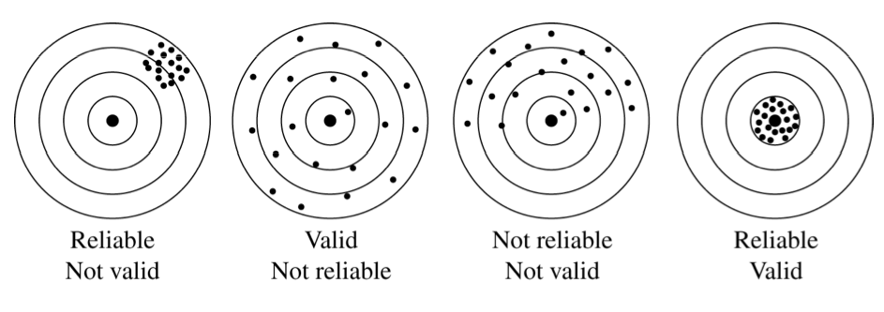
Validity & Reliability in Data
What is validity?
What is reliability?
Notes:
C
<read notes>
Part of our ethical responsibility is looking at our methodologies and processes with data and knowing its statistical accuracy and inaccuracy.
Let’s look at some statistics 101. First we’ll start with What is validity? And what is reliability? Validity is the extent to which a concept, conclusion or measurement is well-founded and likely corresponds accurately to the real world.
Valid derived from Latin to mean “strong.” We’re pretty sure this is not just made up – it actually exists out there and tells a story of something true. But more importantly validity means – we sought out to answer a question (bullseye) and we’re pretty sure this data, this system, this analysis answers that “real-world” question.
Reliability – consistency, we can do this test, run this system, predict this thing happening over and over again and we know it to be true; “have confidence in the results”

Slide 17
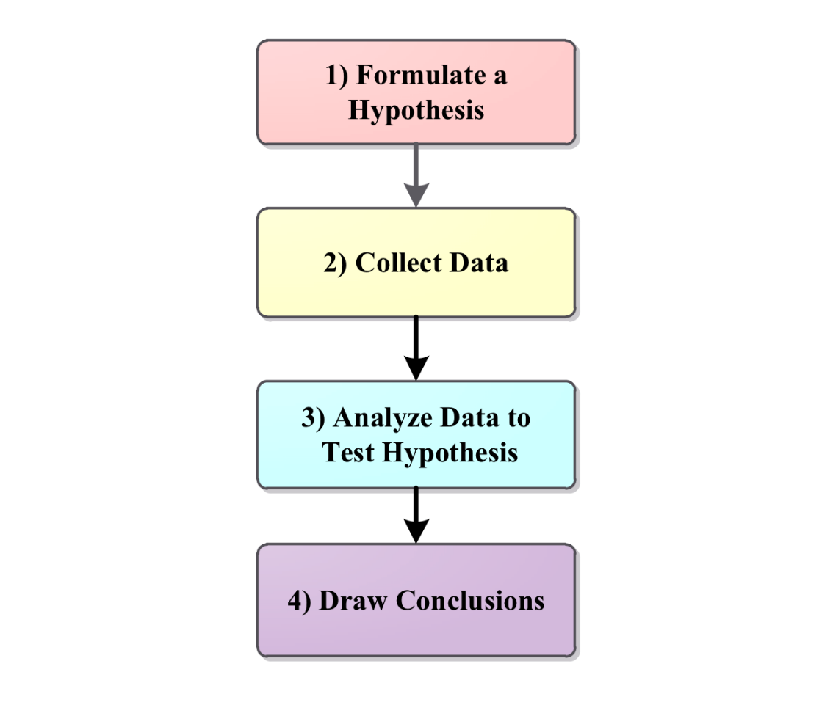
Validity & Reliability in Data
How do we prove something we’ve gathered is valid and reliable?
Hypothesis testing!
Can we truly say our data was valid or reliable?
Notes:
C
<read notes>
So how do we prove something we’ve gathered is valid and reliable?
Through hypothesis testing! Typically, that means we Formulate a Hypothesis, Collect Data, analyze the data to test the hypothesis and then draw our conclusions. But if our data is skewed, our analysis will also be skewed, and we may draw incorrect conclusions.
To put another way, if our collection methods lack credibility,
or our analysis fails to see all the variables in our data, then can we truly say our data was valid or reliable?
But how can we overcome what we don’t know? There’s a few ways:
“independent verification” by consultants or other business entities
SMEs, outside perspectives, third-party analysis
Or simply more diversity of thought in our analysis, which means including people on our teams who have different life experiences than our own, who can give us insights into variables we may have missed… <more on that in the next slide>

Slide 18
Diversity Aids Validity, Counters Bias
“It’s difficult to build technology that serves the world without first building a team that reflects the diversity of the world… A more diverse group of researchers and engineers is more likely to recognize and think harder about bias problems that may even impact them personally.”¹ - Brad Smith, Microsoft, President
¹ Smith, Brad. Tools and Weapons, 2019
Notes:
C
<read notes only>
As Brad Smith with Microsoft once wrote… A more diverse group of researchers and engineers is more likely to recognize and think harder about bias problems.
In IT we know we need complex teams to solve complex problems. We know diverse teams are more productive.
Let’s look at some more examples of bias…

Slide 19
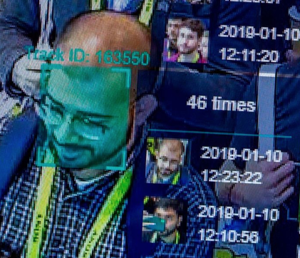
Facial Recognition Technology
“Four out of five people (81%) identified by the Metropolitan Police’s facial recognition technology as suspects are innocent.”^{1,2} “…falsely identified African-American and Asian faces 10 to 100 times more than Caucasian faces.”³
In a test of Amazon’s Rekognition, 28 members of Congress were incorrectly matched as other people who have been arrested for a crime.⁴
1 https://www.theguardian.com/technology/2020/jan/24/met-police-begin-using-live-facial-recognition-cameras
2 https://news.sky.com/story/met-polices-facial-recognition-tech-has-81-error-rate-independent-report-says-11755941?
3 https://www.nytimes.com/2019/12/19/technology/facial-recognition-bias.html
4 https://www.aclu.org/blog/privacy-technology/surveillance-technologies/amazons-face-recognition-falsely-matched-28
Notes:
C
<read notes>
This isn’t the first time we’re gonna mention facial recognition products in this presentation.
In January of 2020 in the United Kingdom, 81% of people identified as suspects by the Metropolitan Police’s facial recognition technology were - in fact - innocent.
Also this same technology falsely identified African-American and Asian faces 10-to-100 times more often than white faces.
In a 2018 test of Amazon’s Rekognition computer vision platform, 28 members of the U.S. Congress were incorrectly matched as other people who have been arrested for a crime.
Without validity or reliability, is it ethical to use a facial recognition software that has pervasive access to public camera systems?
And do we think that law enforcement be transparent and open about the flaws in such a system?
Let’s now talk more about the need for transparency.

Slide 20

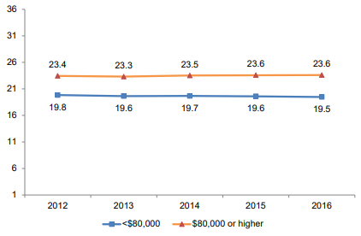
The ACT Test
Measures what students learned in school (valid).
Repeated testing gets similar results (reliable).
In 2016, ACT admitted Family Income explains performance on their test.¹
“More than 1,000 [colleges] have adopted test-optional admissions policies.”²
1 https://www.act.org/content/dam/act/unsecured/documents/R1604-ACT-Composite-Score-by-Family-Income.pdf 2 https://www.usnews.com/news/the-report/articles/2018-10-26/the-new-opt-out-movement-colleges-make-entrance-exams-optional 3 https://www.act.org/content/dam/act/unsecured/documents/5688-data-byte-2016-5-adjusted-differences-in-act-scores-by-family-income.pdf 4 Image: Corporate logo on ACT.org
Notes:
C <read notes>
Many Americans are familiar with the ACT Test, an exam many 18 year olds take as part of their college application process.
ACT has long since stated that the test measures what students learned in school (which means it’s valid). And that repeated testing (if a student takes it over and over again) they’ll get similar results (which means its reliable).
However, in 2016, ACT admitted that family income is a major factor on their test. There is a 3 to 4 point difference between students in poorer and richer households, the line here being at 80 thousand dollars per year. That the gap is widening, according to their own data.
Credit to ACT for disclosing the research here which shows a widening gap among students based on family income.
Later, they tried to explain this gap by indicating that lower-income students also had “lower high school GPAs and less rigorous coursework.” Again, credit to them for at least acknowledging this, but is the ACT ethically testing for high school achievement, or, for opportunity?
If our measurements are valid and reliable, but outcomes are rejected, should we challenge our testing?
Our results are valid as tested, but what about the outcomes? Are they ethical? Are they to be trusted as the result of an impartial algorithm?
In this ACT example, socioeconomic level is a variable – it affects the outcome. What other variables may affect a student’s ACT score, variables that have been studied?
Class size?
Opportunity for private tutoring?
Air quality and temperature of classrooms?
Local crime statistics? Recent local natural disasters?
Home schooled? Public school? Private school?
Number of hours students work a job outside of school?
Recently, more than 1,000 institutions of higher learning have adopted test-optional admissions policies. Meaning they no longer ask for the ACT or SAT on applications. This might question the validity of ACT’s test in terms of what colleges want out of the score, given that so many schools disregard its validity.
An overwhelming amount of studies have been done that say the ACT does NOT predict college graduation outcomes. In fact, a bigger factor that impacts graduation outcomes remains household income.

Slide 21
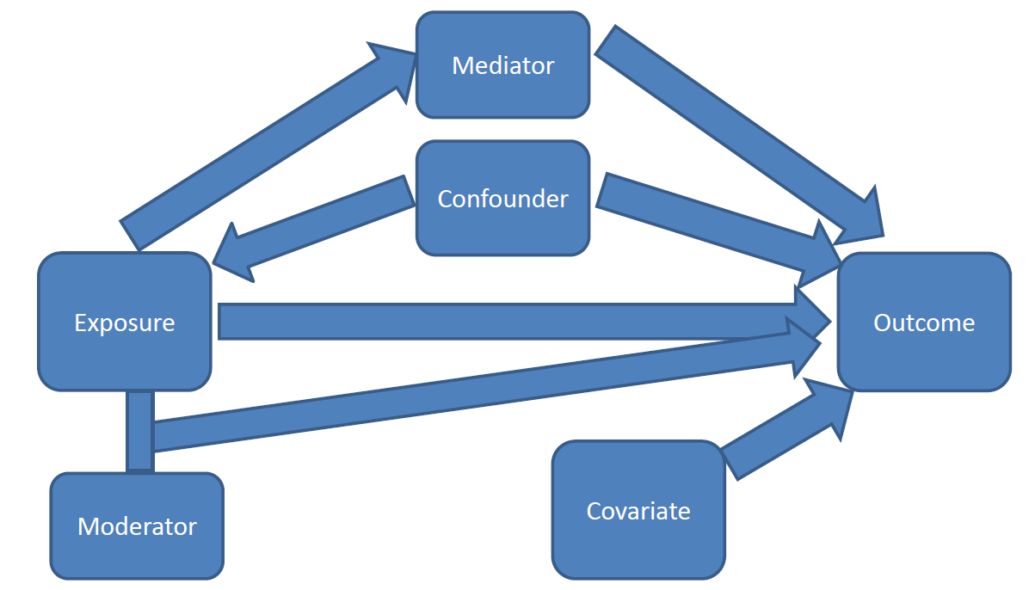
Knowing the Variables
Mediator
Confounder
Moderator
Covariate
You will never find the variables unless you’re looking for them.
Ask: “Are there any other variables that affect the data?”
https://significantlystatistical.wordpress.com/2014/12/12/confounders-mediators-moderators-and-covariates/
Notes:
C
<read notes>
Knowing the variables that are involved in your analysis is important – just as we saw with the ACT.
When conducting analysis, most researchers will review, identify, and map out the variables.
Let’s briefly go through the definitions of some variables and then I’ll give an example that will make the clearer.
<click>
First, understand that mediators and confounders are similar except for the affect or direction they have on exposure and outcome.
Mediators are considered to be “the causal pathway” between exposure and outcome. Which means they seem to naturally occur. <click>
Confounders directly affect both exposure and outcome.
<click>
Moderators are simply interactions that change the size or direction of the effect of the exposure on outcome. It makes the outcome smaller or larger. <click>
And Covariates are variables that might affect outcomes but really are not associated with anything else.
You will never find the variables unless you’re looking for them.
Ask yourself: “Are there any other variables that affect the data?”
There will always be other variables made apparent when you dig. Sometimes you never see them until after your data collection is complete.
Now let’s look at an example…

Slide 22
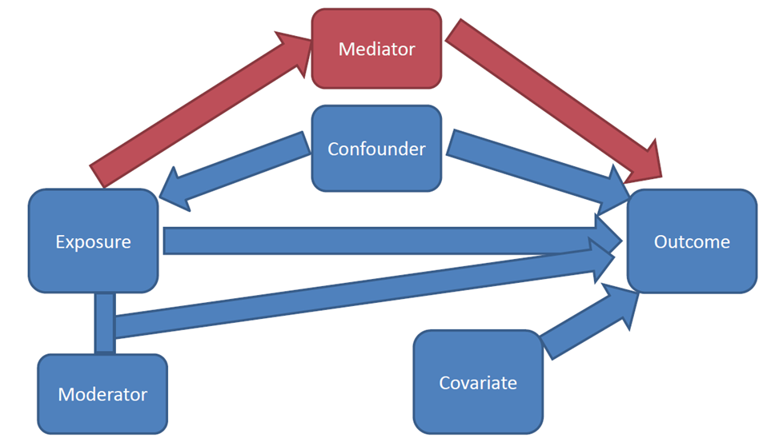
Knowing the Variables
Mediator
Confounder
Moderator
Covariate
You will never find the variables unless you’re looking for them.
Ask: “Are there any other variables that affect the data?”
https://significantlystatistical.wordpress.com/2014/12/12/confounders-mediators-moderators-and-covariates/
Notes:
C
First, understand that mediators and confounders are similar except for the affect or direction they have on exposure and outcome.
Mediators are considered to be “the causal pathway” between exposure and outcome. Which means they seem to naturally occur. <click>
Confounders directly affect both exposure and outcome.
<click>
Moderators are simply interactions that change the size or direction of the effect of the exposure on outcome. It makes the outcome smaller or larger. <click>
And Covariates are variables that might affect outcomes but really are not associated with anything else.
You will never find the variables unless you’re looking for them.
Ask yourself: “Are there any other variables that affect the data?”
There will always be other variables made apparent when you dig. Sometimes you never see them until after your data collection is complete.
Now let’s look at an example…

Slide 23
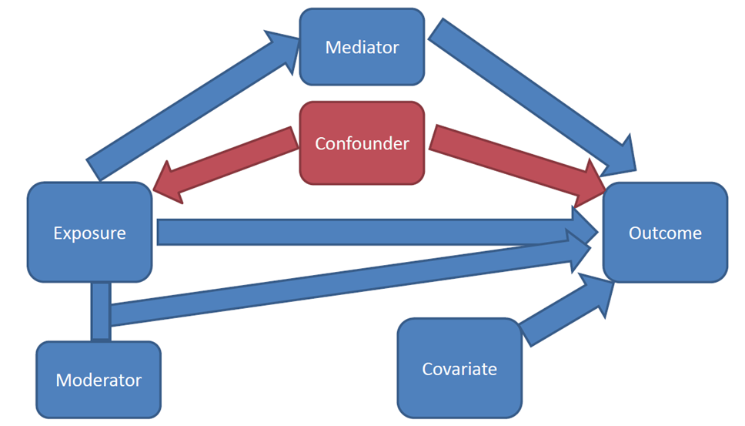
Knowing the Variables
Mediator
Confounder
Moderator
Covariate
You will never find the variables unless you’re looking for them.
Ask: “Are there any other variables that affect the data?”
https://significantlystatistical.wordpress.com/2014/12/12/confounders-mediators-moderators-and-covariates/
Notes:
C
Confounders directly affect both exposure and outcome.
<click>
Moderators are simply interactions that change the size or direction of the effect of the exposure on outcome. It makes the outcome smaller or larger. <click>
And Covariates are variables that might affect outcomes but really are not associated with anything else.
You will never find the variables unless you’re looking for them.
Ask yourself: “Are there any other variables that affect the data?”
There will always be other variables made apparent when you dig. Sometimes you never see them until after your data collection is complete.
Now let’s look at an example…

Slide 24
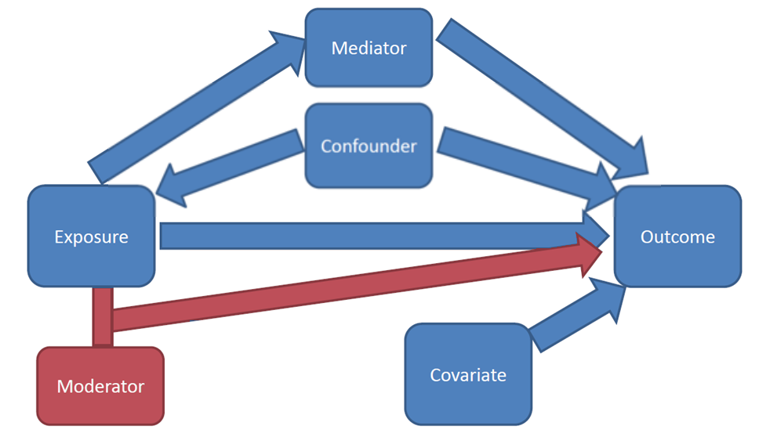
Knowing the Variables
Mediator
Confounder
Moderator
Covariate
You will never find the variables unless you’re looking for them.
Ask: “Are there any other variables that affect the data?”
https://significantlystatistical.wordpress.com/2014/12/12/confounders-mediators-moderators-and-covariates/
Notes:
C
Moderators are simply interactions that change the size or direction of the effect of the exposure on outcome. It makes the outcome smaller or larger. <click>
And Covariates are variables that might affect outcomes but really are not associated with anything else.
You will never find the variables unless you’re looking for them.
Ask yourself: “Are there any other variables that affect the data?”
There will always be other variables made apparent when you dig. Sometimes you never see them until after your data collection is complete.
Now let’s look at an example…

Slide 25
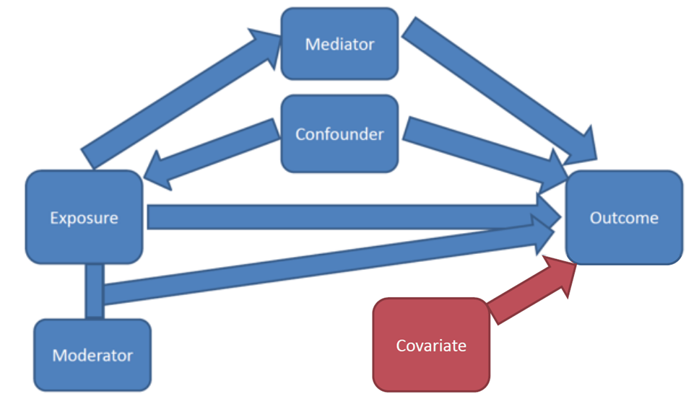
Knowing the Variables
Mediator
Confounder
Moderator
Covariate
You will never find the variables unless you’re looking for them.
Ask: “Are there any other variables that affect the data?”
https://significantlystatistical.wordpress.com/2014/12/12/confounders-mediators-moderators-and-covariates/
Notes:
C
And Covariates are variables that might affect outcomes but really are not associated with anything else.
You will never find the variables unless you’re looking for them.
Ask yourself: “Are there any other variables that affect the data?”
There will always be other variables made apparent when you dig. Sometimes you never see them until after your data collection is complete.
Now let’s look at an example…

Slide 26
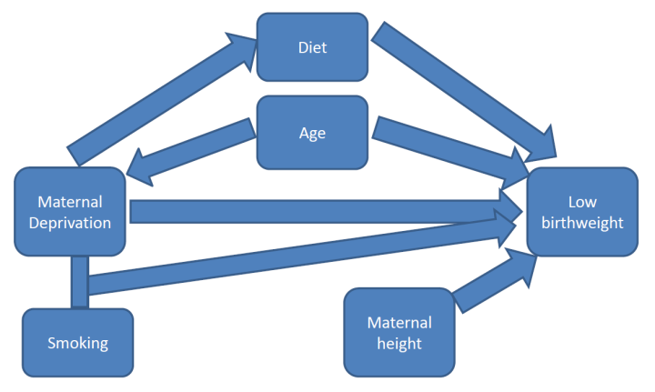
Mediator:
Diet
Confounder:
Age
Moderator:
Smoking
Covariate:
Maternal height
https://significantlystatistical.wordpress.com/2014/12/12/confounders-mediators-moderators-and-covariates/
https://bmjopen.bmj.com/content/4/4/e004514
Notes:
C
<read notes>
We’re going to look at the relationship between poor mothers (shown here as “maternal deprivation”) and low birthweight. We know this to be true. Maternal deprivation (Poor mothers) give birth to babies with lower birthweight. It’s been tested over and over again. This is based on a study to investigate trends in birth rates by socioeconomic deprivation and maternal age in England from 1997 to 2008.
But why? What are the variables that surround it?
Let’s look at our variables…
<click>
Mediator here is diet. Remember Mediator is the “the causal pathway” it’s said to be “naturally occurring”. In this case diet could be due to being poor, and a sub-optimal diet of the mother who is nourishing the unborn child means the baby would be smaller. Usually a mediator variable is something you can’t avoid in your data. It exists and you just need to be aware of it.
<click>
The confounder variable is age here. Remember that confounders affect both the exposure (poor mothers) and the outcome (low birthweight). In our analysis Maternal age may affect poverty (perhaps the younger a mother is, the less money she has, or she could be physically less developed as an older adult woman) and therefore her age is may be associated with low birthweight. This variable could control for though. We could ask for only mothers of certain ages.
<click>
Now remember the moderator affects the size or direction of our outcome. In this case the moderator is smoking. There’s an interaction between poor mothers and smoke exposure on birthweight. Meaning poor mothers tend to smoke which produce babies even smaller. Again, we can control for it if we wanted to. We could look at data for mothers who don’t smoke, or only for those who do.
<click>
Lastly our Covariate here is height. Remember, that this variable is for things we need to account for - because we think they are related to outcome (but really connected to nothing else). Height here could be a factor, but it doesn’t affect the exposure but maybe the outcome. Again, this would be a variable we’d control for in an experiment, but we may or may not be able to.
This brings a great point - When presented with data you may or may not have the ability to “control” for your variables.
Can you remove some variables and not others?
And how do you choose which variables to account for?
What is the reasoning behind your decisions?
Clearly describing where we think or predict the interactions, relationships or pathways exist in our data and our work is incredibly powerful.
Mapping, reviewing, analyzing our data for all the variables that could bias our data can help in mitigating bias.

Slide 27
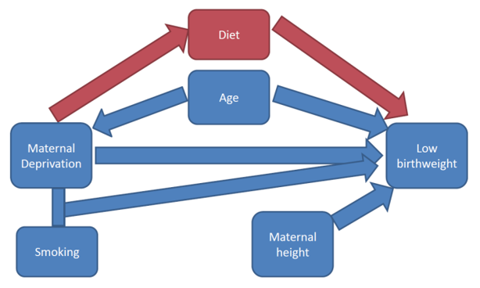
Mediator:
Diet
Confounder:
Age
Moderator:
Smoking
Covariate:
Maternal height
https://significantlystatistical.wordpress.com/2014/12/12/confounders-mediators-moderators-and-covariates/
Notes:
C
Mediator here is diet. Remember Mediator is the “the causal pathway” it’s said to be “naturally occurring”. In this case diet could be due to being poor, and a sub-optimal diet of the mother who is nourishing the unborn child means the baby would be smaller. Usually a mediator variable is something you can’t avoid in your data. It exists and you just need to be aware of it.
<click>
The confounder variable is age here. Remember that confounders affect both the exposure (poor mothers) and the outcome (low birthweight). In our analysis Maternal age may affect poverty (perhaps the younger a mother is, the less money she has, or she could be physically less developed as an older adult woman) and therefore her age is may be associated with low birthweight. This variable could control for though. We could ask for only mothers of certain ages.
<click>
Now remember the moderator affects the size or direction of our outcome. In this case the moderator is smoking. There’s an interaction between poor mothers and smoke exposure on birthweight. Meaning poor mothers tend to smoke which produce babies even smaller. Again, we can control for it if we wanted to. We could look at data for mothers who don’t smoke, or only for those who do.
<click>
Lastly our Covariate here is height. Remember, that this variable is for things we need to account for - because we think they are related to outcome (but really connected to nothing else). Height here could be a factor, but it doesn’t affect the exposure but maybe the outcome. Again, this would be a variable we’d control for in an experiment, but we may or may not be able to.
This brings a great point - When presented with data you may or may not have the ability to “control” for your variables.
Can you remove some variables and not others?
And how do you choose which variables to account for?
What is the reasoning behind your decisions?
Clearly describing where we think or predict the interactions, relationships or pathways exist in our data and our work is incredibly powerful.
Mapping, reviewing, analyzing our data for all the variables that could bias our data can help in mitigating bias.

Slide 28
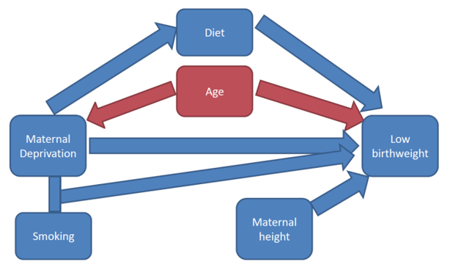
Mediator:
Diet
Confounder:
Age
Moderator:
Smoking
Covariate:
Maternal height
https://significantlystatistical.wordpress.com/2014/12/12/confounders-mediators-moderators-and-covariates/
Notes:
C
The confounder variable is age here. Remember that confounders affect both the exposure (poor mothers) and the outcome (low birthweight). In our analysis Maternal age may affect poverty (perhaps the younger a mother is, the less money she has, or she could be physically less developed as an older adult woman) and therefore her age is may be associated with low birthweight. This variable could control for though. We could ask for only mothers of certain ages.
<click>
Now remember the moderator affects the size or direction of our outcome. In this case the moderator is smoking. There’s an interaction between poor mothers and smoke exposure on birthweight. Meaning poor mothers tend to smoke which produce babies even smaller. Again, we can control for it if we wanted to. We could look at data for mothers who don’t smoke, or only for those who do.
<click>
Lastly our Covariate here is height. Remember, that this variable is for things we need to account for - because we think they are related to outcome (but really connected to nothing else). Height here could be a factor, but it doesn’t affect the exposure but maybe the outcome. Again, this would be a variable we’d control for in an experiment, but we may or may not be able to.
This brings a great point - When presented with data you may or may not have the ability to “control” for your variables.
Can you remove some variables and not others?
And how do you choose which variables to account for?
What is the reasoning behind your decisions?
Clearly describing where we think or predict the interactions, relationships or pathways exist in our data and our work is incredibly powerful.
Mapping, reviewing, analyzing our data for all the variables that could bias our data can help in mitigating bias.

Slide 29
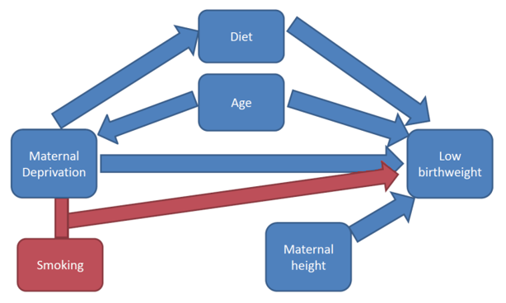
Mediator:
Diet
Confounder:
Age
Moderator:
Smoking
Covariate:
Maternal height
https://significantlystatistical.wordpress.com/2014/12/12/confounders-mediators-moderators-and-covariates/
Notes:
C
Now remember the moderator affects the size or direction of our outcome. In this case the moderator is smoking. There’s an interaction between poor mothers and smoke exposure on birthweight. Meaning poor mothers tend to smoke which produce babies even smaller. Again, we can control for it if we wanted to. We could look at data for mothers who don’t smoke, or only for those who do.
<click>
Lastly our Covariate here is height. Remember, that this variable is for things we need to account for - because we think they are related to outcome (but really connected to nothing else). Height here could be a factor, but it doesn’t affect the exposure but maybe the outcome. Again, this would be a variable we’d control for in an experiment, but we may or may not be able to.
This brings a great point - When presented with data you may or may not have the ability to “control” for your variables.
Can you remove some variables and not others?
And how do you choose which variables to account for?
What is the reasoning behind your decisions?
Clearly describing where we think or predict the interactions, relationships or pathways exist in our data and our work is incredibly powerful.
Mapping, reviewing, analyzing our data for all the variables that could bias our data can help in mitigating bias.

Slide 30
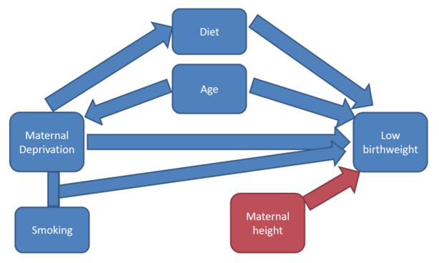
Mediator:
Diet
Confounder:
Age
Moderator:
Smoking
Covariate:
Maternal height
https://significantlystatistical.wordpress.com/2014/12/12/confounders-mediators-moderators-and-covariates/
Notes:
C
Lastly our Covariate here is height. Remember, that this variable is for things we need to account for - because we think they are related to outcome (but really connected to nothing else). Height here could be a factor, but it doesn’t affect the exposure but maybe the outcome. Again, this would be a variable we’d control for in an experiment, but we may or may not be able to.
This brings a great point - When presented with data you may or may not have the ability to “control” for your variables.
Can you remove some variables and not others?
And how do you choose which variables to account for?
What is the reasoning behind your decisions?
Clearly describing where we think or predict the interactions, relationships or pathways exist in our data and our work is incredibly powerful.
Mapping, reviewing, analyzing our data for all the variables that could bias our data can help in mitigating bias.

Slide 31
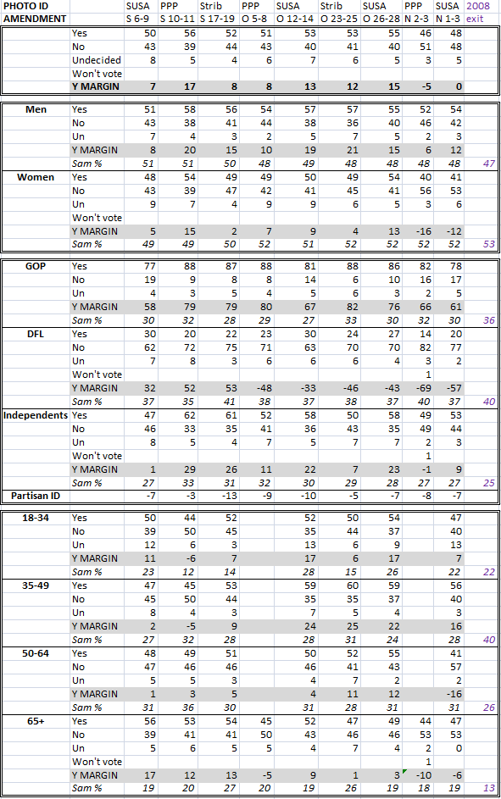
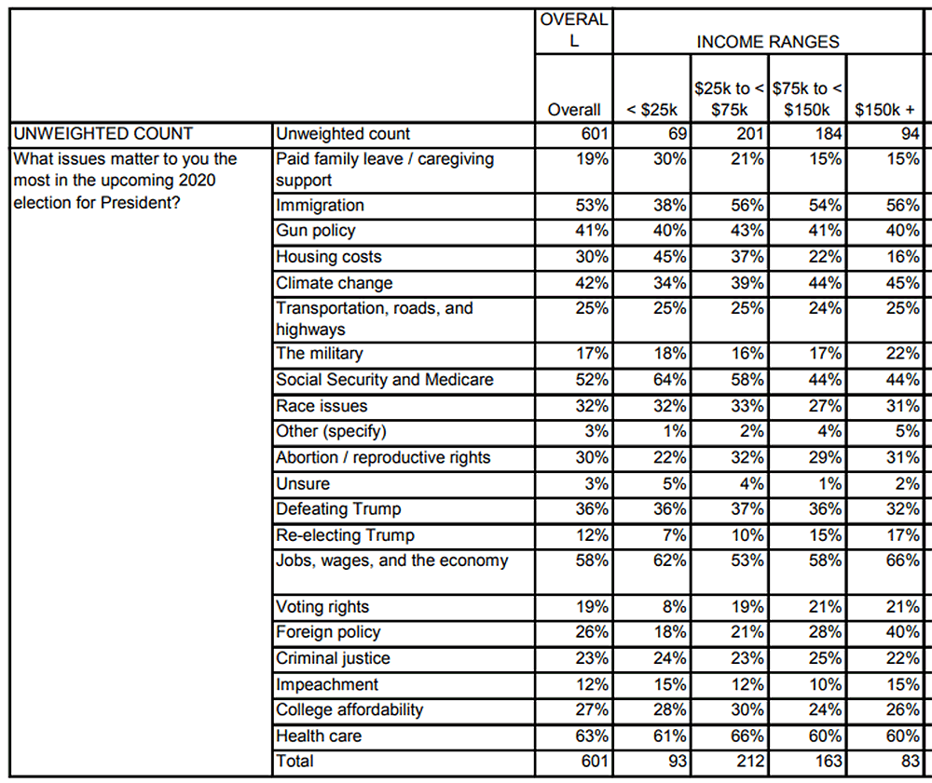
Election Polling
Non-traditional political pollsters are mysteriously more accurate when there is a “gold standard” poll in the same race.¹
A “gold standard” poll is a live phone call survey.
There is an urge to mold data to fit others’ findings, so that we don’t appear to be a fringe source.²
Polling data should always provide the crosstabs.
¹ https://fivethirtyeight.com/features/are-bad-pollsters-copying-good-pollsters/
² https://fivethirtyeight.com/features/pollsters-say-they-follow-ethical-standards-but-they-arent-so-sure-about-their-peers/
Example crosstabs Image (L): https://www.minnpost.com/braublog/2012/11/super-crosstabs-obama-soars-photo-id-plunges-marriage-amendment-slips/
Example crosstabs Image (R): https://www.wbur.org/news/2019/09/11/wbur-issue-survey-takeaways
Notes:
WILLIAM
<read the notes>
Let’s talk about transparency as part of overcoming bias. Here’s an example from the United States where political pollsters may have altered their data to fit the competition
In a study by the website 538, non-traditional pollsters (like online surveys or automated systems) were “allegedly” cheating by peeking at “gold standard” poll. A “gold standard” poll is a live person to person phone call survey. Non-traditional political polls are mysteriously more accurate when there is a “gold standard” poll in the same election, and less accurate when there is not a “gold standard” poll.
So when there was a “gold standard” for that election, the non-traditional polls were more accurate.
No “gold standard” for a small election in Alaska? The non-traditional polls were less accurate.
<next>

Slide 32
Election Polling
Non-traditional political pollsters are mysteriously more accurate when there is a “gold standard” poll in the same race. Less accurate when no “gold standard” poll.¹
There is an urge to mold data to fit others’ findings, so that we don’t appear to be a fringe source.²
Polling data should always provide the crosstabs.
¹ https://fivethirtyeight.com/features/are-bad-pollsters-copying-good-pollsters/
² https://fivethirtyeight.com/features/pollsters-say-they-follow-ethical-standards-but-they-arent-so-sure-about-their-peers/
Example crosstabs Image (L): https://www.minnpost.com/braublog/2012/11/super-crosstabs-obama-soars-photo-id-plunges-marriage-amendment-slips/
Example crosstabs Image (R): https://www.wbur.org/news/2019/09/11/wbur-issue-survey-takeaways
Notes:
WILLIAM
<read the notes>
A couple examples here of the “crosstabs” in a political poll. A detailed data table of the polling results, per demographic breakdown, per question. A common response to big or sensational headlines about political poll results should always be, “show the crosstabs”.
Transparency should include not only the “crosstabs” of your results, but a disclosure/discussion of known historical biases.
Your data tells a story – there may be a tendency to want manipulate the data to fit the story you want to tell. How can you “show the crosstabs”, show the detail and the proof, in your work?

Slide 33
Disclosure of Bias
“It is worth pointing out that every study has its confounding variables and limitations. Confounding effect cannot be completely avoided. Every scientist should therefore be aware of all potential sources of bias and undertake all possible actions to reduce and minimize the deviation from the truth. If deviation is still present, authors should confess it in their articles by declaring the known limitations of their work.”¹
¹ Simundić AM. Bias in research. Biochem Med (Zagreb). 2013;23(1):12-15. doi:10.11613/bm.2013.003 https://www.ncbi.nlm.nih.gov/pmc/articles/PMC3900086/
Notes:
C
This is a quote from a paper published in the journmal Biochemia Medica.
<read quote>
Failure to provide that transparency begs accusations of a biased interpretation.

Slide 34
Apple Credit Card (2019)
Men were given higher credit limits.
Women’s income inequality provided a historically biased look at gender.
“No one from Apple seemed able to describe how the algorithm even worked, let alone justify its output. While Goldman Sachs, the issuing bank for the Apple Card, insisted that there isn't any gender bias in the algorithm, it failed to offer proof.”¹
¹ https://www.wired.com/story/the-apple-card-didnt-see-genderand-thats-the-problem/
² https://www.nytimes.com/2019/11/10/business/Apple-credit-card-investigation.html
Notes:
C
<read notes>
Let’s look at an example with biased outcomes and no transparency.
In 2019, Apple issued Credit Cards and men were given higher credit limits than women, even higher than their wives.
How could this be? Could women’s income inequality be a variable? Women’s income inequality provides a historically biased look at gender.
A quote from Wired Magazine, “No one from Apple seemed able to describe how the algorithm even worked, let alone justify its output. While Goldman Sachs, the issuing bank for the Apple Card, insisted that there isn't any gender bias in the algorithm, it failed to offer proof.”
This is an example of Apple not even being AWARE of their bias, much less disclosing it publicly (which would have been embarrassing).
Apple is now being investigated by regulators.² – so these kind of errors may result in legal implications.
One could be challenged on disparate impact (particularly in employment areas) – we’ll talk about disparate impact a bit later.

Slide 35
Support Your Conclusions
That’s why we’re talking about steroids, censorship, disparate sentencing outcomes on race, facial recognition, ACT test outcomes, and the Apple credit cards.
Transparency, at least internally, to how an algorithm works is key to acknowledging bias in outcomes.
Notes:
C
You need to be able to support your conclusions.
<read the slide>

Slide 36
Data Collection
Notes:
WILLIAM
Let’s dive deeper into this ethical problem.
We’ve talked about transparency in analysis,
let’s talk about ethics in data collection.
What are our ethical responsibilities in collection and ownership of citizens’ data?
Let’s go over a couple bad examples.

Slide 37
Target’s Scandal re: Pregnant Daughter
Ethical collection: consumer retail shopping habits from Target stores
Unethical use: expectant mother coupons (to a high schooler who’d been hiding pregnancy)
“We are very conservative about compliance with all privacy laws. But even if you’re following the law, you can do things where people get queasy.”¹ –Target statistician Andrew Pole
¹ https://www.nytimes.com/2012/02/19/magazine/shopping-habits.html?pagewanted=1&_r=1&hp
Notes:
WILLIAM
<read the notes>
You may be familiar with the story about American retailer Target’s direct mail campaign for expectant mothers and a furious dad, who didn’t know his teenage daughter was pregnant yet.
Quote is from Andrew Pole, the Target statistician who developed the store’s model for predicting and detecting consumer pregnancies, which were then used to target ads to expectant mothers.
<read quote>
Ethical collection, unethical use, resulting in a violation of privacy for a sensitive topic. What if this ad arrived shortly after a miscarriage? It’d be different if Target were, say, sending mailers people about to buy shoes, or toys, or a car, but a pregnancy?
Target’s statistician says that even if you’re following privacy laws and regulations, you still may trip over ethical lines.

Slide 38
Facebook + Cambridge Analytica
Unethical collection: Gathered data on 87+ million users without their consent.
Use of data ethically questionable
Whistleblower: CA shared data with Russian proxies for “rumour campaigns”, “attitudinal inoculation”¹, and “psychological warfare.”²
1 https://www.youtube.com/watch?v=Zy16v0oIo3s 2 https://www.npr.org/2018/05/16/611412562/whistleblower-cambridge-analytica-aimed-to-trigger-paranoia-and-racial-biases 3 https://www.vox.com/policy-and-politics/2018/3/23/17151916/facebook-cambridge-analytica-trump-diagram 4 https://www.vox.com/policy-and-politics/2017/10/16/15657512/cambridge-analytica-facebook-alexander-nix-christopher-wylie
Notes:
WILLIAM
<read the notes>
British firm Cambridge Analytica gathered the data on 87+ million Facebook users without their consent, via what Facebook later labeled “malicious” use of its developer system. Any user who took their custom Facebook “personality quiz” also - unknowingly - allowed CA to access their personal data and the personal data - including location - for all their “friends”. Clearly, unethical collection.
<next>
CA used the data to perform “Digital Operations” to target future president Trump’s 2016 campaign messaging, using quote “5000 points of data on every voter”, to set the campaign travel schedule, platform, and to micro-target Facebook users with $1 million dollars a day in ads. Maybe that’s not unethical use, but it was based on unethically collected data.
<next>
These quotes you see here are from the Cambridge Analytica data analyst Christopher Wylie, turned whistle blower who testified in both the US and UK in 2018.³
CA later shared the Facebook data with Russian proxies for “rumour campaigns” and “attitudinal inoculation”¹, and “psychological warfare.”²
Wylie, when we worked at CA, did not believe their collection and analysis was unethical. He does now.

Slide 39
Consent
Where is it recorded that users signed off on the privacy policy?
Where is it recorded that participants asked to be contacted in the future, or on a “do not call” list?
Are we transparent about our use or potential re-use of the data?
Does our approach rely on consumers being gullible, or tricking consumers?
Notes:
WILLIAM
<read notes, then slide>
Analysts must be aware of consent mechanisms, both how they were collected, and more logistically, how this data on consent can be incorporated into future analysis.

Slide 40
Control Creep
“Control creep" refers to data that has been generated with a particular purpose in mind, but which is repurposed.
For example, harvesting consumer data for research purposes, then selling the data, or, using genetic data for employment.
Sickle cell trait discrimination
¹ https://www.genome.gov/10001732/genetic-information-and-the-workplace-report
² https://www.eeoc.gov/laws/guidance/enforcement-guidance-disability-related-inquiries-and-medical-examinations-employees
³ https://webcache.googleusercontent.com/search?q=cache:LmaFv_ORZKEJ:https://rct.learningpool.com/pluginfile.php/711/mod_folder/content/0/Saesneg%2520-%2520English/Factsheet%2520on%2520Sickle%2520Cell%252012_13.doc.pdf%3Fforcedownload%3D1+&cd=1&hl=en&ct=clnk&gl=us
⁴ https://news.bloomberglaw.com/daily-labor-report/employers-cant-require-back-to-work-antibody-tests-eeoc-says
Notes:
WILLIAM
<read notes>
Let’s talk more about that “potential re-use” of data. “Control creep" refers to data that has been generated with a particular purpose in mind, but which is repurposed.
<click>
Can you think of genetic data example that has been identified as having a disparate impact, that is now federally banned in the U.S. for use in hiring?
<click>
For example, employers in the United States used genetic screening in the early 1970s to identify potential employees who carried a gene mutation for sickle cell anemia, a very expensive and periodically debilitating genetic disorder that is predominant in African Americans. “Those carrying the gene mutation were denied jobs-even though many of them were healthy and would never develop the disease.”¹
In the United States, Americans with Disabilities Act of 1990 put an end to sickle cell trait discrimination in employment and its disparate outcomes on race.² In the UK, the Equality Act 2010 provided for the same.³
Similarly, a predictive genetic test for expensive cancers or diseases must not be a prerequisite for joining an employer’s health care coverage. That would be, unethical.
As personal health data devices and services become more prevalent in our society, let’s be wary of potential misuse and discrimination based on predictive health markers.

Slide 41
Control Creep
Unethical, potentially illegal re-purposing of financial data
Using financial data for health care marketing is potentially predatory or discriminatory, and vice versa.
Bias from of socioeconomic trends
“Weblining” is the use of financial data to target users for online ads including childcare, housing, health care.¹
1 https://www.researchgate.net/publication/266910451_The_Good_the_Bad_and_the_Ugly_Applying_Rawlsian_Ethics_In_Data_Mining_Marketing
Notes:
WILLIAM
<read notes>
Using financial data for health care research is potentially predatory or discriminatory, and vice versa, where only wealthy patients are told about the best and more expensive treatments.
<next>
This also leads to a relatively new concept of “Weblining”, or the use of financial data to target users for online ads including childcare, housing, health care.¹ This is a play of words on Redlining, which we’ll talk more about soon. Financial data may be predatory if lower income consumers are targeted with subprime lending, high interest credit cards, or high-fee banking advertisements.
We should be aware, and transparent, of potential control creep in data we control.

Slide 42
Disparate Impact
Notes:
CHRISTINE
We’ll talk more about Weblining later, because it can contribute to digitizing an Disparate Impact. We mentioned this earlier with the Apple Card algorithm having a disparate impact on women, of facial recognition’s disparate impact on darker-skinned individuals.
Most systems (selection systems especially) are built to intend to discriminate meaning they create distinctions among people. (repeat)
But there’s various laws about discrimination on the basis of age, gender, race, etc., these laws are most notably around employment, housing, public accommodation…
In the United States for example, there are two forms of ILLEGAL discrimination:
Disparate treatment (active discrimination): intentional and open bias, retaliation, or exclusionary
Disparate (adverse) impact (passive discrimination): You’re sometimes unaware they exist in your systems.

Slide 43
Disparate Impact
Analytical models or predictive models must either account for and be aware of past trends, or become guilty of continuing and institutionalizing past trends.
Your data analysis must expose and control for disparate impact, or will contribute to it.
¹ https://www.nytimes.com/roomfordebate/2015/04/27/can-discrimination-exist-without-clear-intent/unintentional-discrimination-is-as-harmful-as-real-bias
Notes:
CHRISTINE
<click> <read notes>
In the case of housing discrimination, the doctrine of “disparate impact recognizes that implicit biases can produce discriminatory results — even without intent — and allows for such results to be remedied.”¹
<read slide>

Slide 44
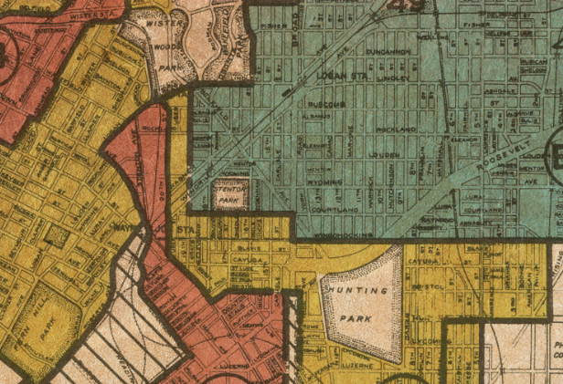
Redlining
1934-68: Federal Housing Authority (FHA) Redlining
1968: Fair Housing Act
1974: Equal Credit Opportunity Act
1977: Community Reinvestment Act
1 Image: University of Richmond digital scholarship lab Retrieved from: https://www.revealnews.org/article/for-people-of-color-banks-are-shutting-the-door-to-homeownership/
2 https://www.revealnews.org/article/for-people-of-color-banks-are-shutting-the-door-to-homeownership/ 3 https://www.washingtonpost.com/news/wonk/wp/2018/03/28/redlining-was-banned-50-years-ago-its-still-hurting-minorities-today/
Notes:
WILLIAM
<read notes>
Brief history of redlining, a term used in the United States and Canada to describe once-legal housing segregation.
Red lines were literally drawn on maps around “undesirable” minority neighborhoods, marking them as “undesirable” and hazardous for financing. This denied Federal housing authority-insured mortgages to minority families. Literally legalized disparate impact, by the FHA. Many of you as young people may have used the FHA-subsidized loans to make your first home purchase. We did.
In the 1930s, the FHA surveyed neighborhoods in 239 cities, color-coding them green for “best,” blue for “still desirable,” yellow for “definitely declining” and red for “hazardous.” The “redlined” areas were the ones local lenders considered unsuitable areas for investment, because of the residents’ racial and ethnic demographics.

Slide 45
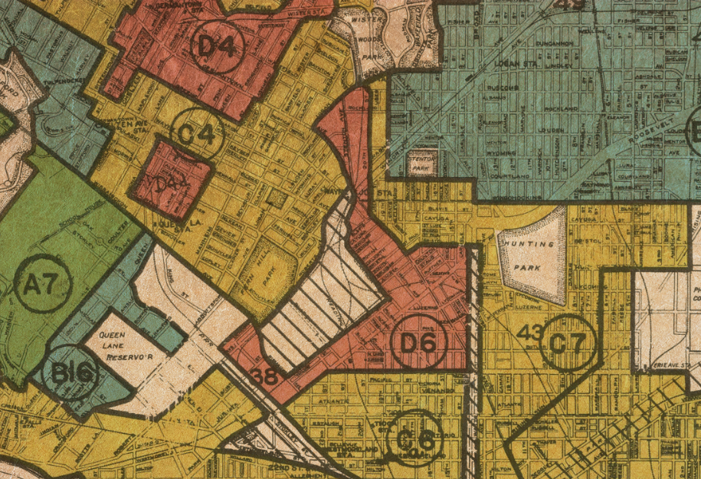
Redlining
1934-68: Federal Housing Authority (FHA) Redlining
1968: Fair Housing Act
1974: Equal Credit Opportunity Act
1977: Community Reinvestment Act
1 Image: University of Richmond digital scholarship lab Retrieved from: https://www.revealnews.org/article/for-people-of-color-banks-are-shutting-the-door-to-homeownership/
2 https://www.revealnews.org/article/for-people-of-color-banks-are-shutting-the-door-to-homeownership/ 3 https://www.washingtonpost.com/news/wonk/wp/2018/03/28/redlining-was-banned-50-years-ago-its-still-hurting-minorities-today/
Notes:
WILLIAM
<read notes>
This is an actual redlining map from 1937 from Philadelphia, Pennsylvania. Maps like this were used throughout the country. It wasn’t really undone in the U.S. until a series of laws 1970s required banks to meet the lending needs of low income neighborhoods.
The American Dream of home ownership was denied to “Baby Boomer” minorities, legally through the 1970s, and that generational gap continues today, fifty years later. 3 out of 4 neighborhoods “redlined” on government maps 80 years ago continue to struggle economically. And despite laws in place, disparate racial outcomes continue in housing. “Fifty years after the federal Fair Housing Act, African Americans and Latinos continue to be routinely denied conventional mortgage loans at rates far higher than their white counterparts.”³

Slide 46
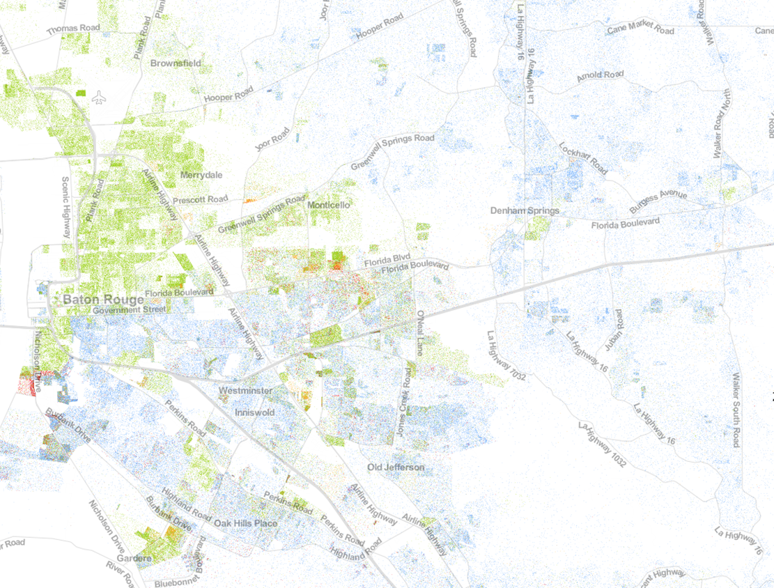
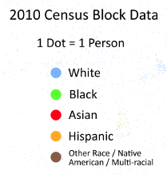
https://demographics.coopercenter.org/racial-dot-map
Notes:
WILLIAM
This is a racial dot map in my home town of Baton Rouge, Louisiana (in the United States). It shows racial demographic data from the 2010 US census.
<click>
See if you can spot Florida Blvd on this map, a historical redlining boundary
<click>
If you can’t, try this zoom without the road names.
If you’re a bank, your analysis on market segmentation may be furthering historical racial housing segregation if you are ignoring minority areas for special rate loan offers, ATM locations, service locations, assessments, etc. Even if you aren’t intending to exclude minorities from your financial services, by ignoring 85 years of racial subdividing, you may be extending that historical trend.
If say, despite your best intentions, your outcome was that 80% of your mortgages were written to whites… in a majority black city like Baton Rouge, your bank could only be judged by its outcomes, not by your best intentions.

Slide 47
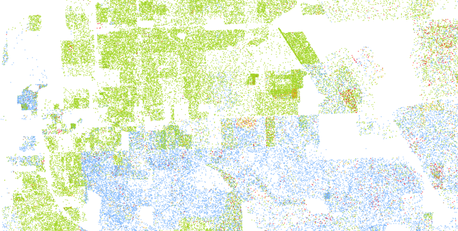
https://demographics.coopercenter.org/racial-dot-map
Notes:
WILLIAM
This is a racial dot map in my home town of Baton Rouge, Louisiana in the United States. It shows racial demographic data from the 2010 US census.
<click>
See if you can spot Florida Blvd on this map, a historical redlining boundary
<click>
If you can’t, try this zoom without the road names.
If you’re a bank, your analysis on market segmentation may be furthering historical racial housing segregation if you are ignoring minority areas for special rate loan offers, ATM locations, service locations, assessments, etc. Even if you aren’t intending to exclude minorities from your financial services, by ignoring 85 years of racial subdividing, you may be extending that historical trend.
If say, despite your best intentions, your outcome was that 80% of your mortgages were written to whites… in a majority black city like Baton Rouge, your bank could only be judged by its outcomes, not by your best intentions.

Slide 48
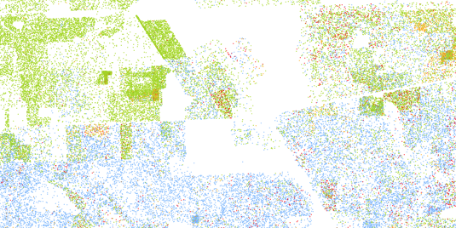
https://demographics.coopercenter.org/racial-dot-map
Notes:
WILLIAM
This is a racial dot map in my home town of Baton Rouge, Louisiana in the United States. It shows racial demographic data from the 2010 US census.
<click>
See if you can spot Florida Blvd on this map, a historical redlining boundary
<click>
If you can’t, try this zoom without the road names.
If you’re a bank, your analysis on market segmentation may be furthering historical racial housing segregation if you are ignoring minority areas for special rate loan offers, ATM locations, service locations, assessments, etc. Even if you aren’t intending to exclude minorities from your financial services, by ignoring 85 years of racial subdividing, you may be extending that historical trend.
If say, despite your best intentions, your outcome was that 80% of your mortgages were written to whites… in a majority black city like Baton Rouge, your bank could only be judged by its outcomes, not by your best intentions.

Slide 49
Disparate Impact
Only outcomes can measure disparate impact.
Disparate Impact is not based on intentions.
It is not legal for companies to blame their algorithm to avoid penalties.^{1,2,3}
1 https://www.revealnews.org/article/can-algorithms-be-racist-trumps-housing-department-says-no/
2 https://www.nytimes.com/2019/08/20/upshot/housing-discrimination-algorithms-hud.html 3 https://www.eff.org/deeplinks/2019/09/dangerous-hud-proposal-would-effectively-insulate-parties-who-use-algorithms
Notes:
C
<read slide first, next, next>
There are decades of legal precedent, most recently upheld by the Supreme Court in 2015, that permit the use of statistical analysis to –identify- patterns of discrimination, but not excuse it.¹

Slide 50
“Weblining” or Digital Redlining
Collecting data, segmenting based on income, resulting in disparate offers, exposure.
“Social sorting” affects and inﬂuences both the choices and opportunities of proﬁled individuals.¹
Facebook allowed housing ads to target based on religion, race, sex, disability.²
A 2013 Harvard study found racial discrimination in Google’s Online Ad Delivery.³
¹ https://www.researchgate.net/publication/266910451_The_Good_the_Bad_and_the_Ugly_Applying_Rawlsian_Ethics_In_Data_Mining_Marketing
² https://www.hud.gov/press/press_releases_media_advisories/HUD_No_19_035 ³ https://dataprivacylab.org/projects/onlineads/1071-1.pdf
Notes:
C
<read notes>
We’ve discussed Disparate Impact in housing, now let’s discuss more modern, online examples.
“Weblining” or “Digital Redlining” is the segmentation of consumer data based on income. This may result in disparate exposure to online ads and services, like in childcare, housing, or health care.
<next>
“Social sorting” is the coding and classifying of aggregate data, and “Social sorting” affects both the choices and opportunities of proﬁled individuals. Facebook for example was investigated for allowing housing ads to target based on religion, race, sex, disability, more. This allowed for obvious housing discrimination, which is already illegal.
<next>
Another example is a study that found discrimination in Google’s Online Ad Delivery. Google Ads featuring the headline “Have you ever been arrested?” were sent more frequently to racially black sounding names than white sounding names.

Slide 51
Arkansas Medicaid coverage algorithm
In 2017 “4,000+ disabled and elderly Arkansans saw their Medicaid benefits cut due to an unannounced rule change.”¹
In 2018, the AR Dept of Human Services was held in contempt of court over its use of the algorithm.²
Eventually, the state legislature cut benefits after a lengthy court battle – the algorithm won.³
¹ https://arktimes.com/news/arkansas-reporter/2017/10/12/dhs-rule-change-threatens-disabled-care?oid=10388695
² https://arktimes.com/news/arkansas-reporter/2018/05/31/archoices-rule-blocked
³ https://arktimes.com/arkansas-blog/2018/12/22/dhs-set-to-impose-medicaid-spending-caps-for-at-home-services-under-archoices
⁴ https://papers.ssrn.com/sol3/papers.cfm?abstract_id=1012360
Notes:
WILLIAM
<read notes>
Another example of disparate impact is a pretty clear case of a bad outcome of an algorithm. In 2017, thousands of disabled or elderly in the state of Arkansas (in the United States) lost Medicaid funding for life-critical in-home caregivers.
<animation>
Perhaps the cuts were unintentional at first, but also they were unannounced, implemented without caution or review for disparate impact, and then defended by the state for years. Even once the state was held in contempt by a judge for continuing to use the algorithm.
<animation>
Eventually, the state legislature made permanent the benefit cuts after a lengthy court battle – the algorithm won. This is a cautionary tale speaks to the lack of due process and transparency to a decision, blindly trusting in an “algorithm’s decision”.⁴
If transparency and mitigating bias are our goals, then we must review the outcomes, and strive for transparency.

Slide 52
Facial Recognition
An MIT study of commercial AI facial recognition products found to have over-relied on photos of lighter-skinned males for training models.¹
The task of identifying the genders of African and European parliament showed a 1/3 failure rate.¹
An FBI co-authored study indicates that facial recognition software is less accurate on darker skin.²
¹ https://www.media.mit.edu/projects/gender-shades/overview/ ² https://www.perpetuallineup.org/
³ https://apnews.com/9406d44edad083ee04e28646ead58ec7?utm_source=Twitter&utm_campaign=SocialFlow&utm_medium=AP ⁴ https://www.theverge.com/2020/3/24/21192333/speech-recognition-amazon-microsoft-google-ibm-apple-siri-alexa-cortana-voice-assistant ⁵ https://arstechnica.com/tech-policy/2020/06/detroit-police-chief-admits-facial-recognition-is-wrong-96-of-the-time/ ⁶ https://epic.org/privacy/ftc/hirevue/EPIC_FTC_HireVue_Complaint.pdf ⁷ https://www.washingtonpost.com/technology/2019/10/22/ai-hiring-face-scanning-algorithm-increasingly-decides-whether-you-deserve-job/
8 Bergstrom, Carl T.; West, Jevin D.. Calling Bullshit (p. 79). Random House Publishing Group. Kindle Edition. 9 https://www.netflix.com/title/81328723
Notes:
WILLIAM
<read notes>
In another case, three different commercial AI products, from IBM, Microsoft, and Face++, used skewed data samples that overrepresented lighter skinned males, and vastly unrepresented and therefore underperformed when trying to identify women or people with darker skin.¹
In a simpler example of biased sample representation, suppose you decide to estimate the average height of a human by using data from professional basketball players. Since basketball players are taller than average, so your sample will not be representative of the population, and your data is biased at the time of collection.⁸ Bias might be less obvious to detect. As we see in the commercial AI facial recognition products, what if that bias is allowed to progress all the way through the development of the machine learning model, to deployment in the field? <next>
In the MIT study, on the task of identifying the genders of African and European parliament members, the platforms showed a 1/3 failure rate. For MIT researcher and computer scientist Joy (buh-lam-WEE-nee) Buolamwini, who is black, her face was not even detected. There is now a Netflix documentary on her work at MIT and her study, the documentary is titled Coded Bias.⁹ You may be interested in viewing. This is a common issue for my black colleagues and many black students forced online around the world during the pandemic – cameras, especially visible light cameras without infrared sensors, aren’t recognizing their faces, and modern algorithms aren’t trained to detect darker skin faces.
<next>
An FBI co-authored study indicates that facial recognition software is less accurate on darker skin.
Similarly, personal voice assistants like Google Home and Amazon’s Alexa struggle with black voices. Speech recognition algorithms disproportionately misunderstand black speakers, for the same reasons – poorly sampled source data.⁴
So, when this type of facial recognition is used in law enforcement, and is less accurate on darker-skinned citizens, the potential if not inevitability for a civil rights disaster is high. In fact, they have already happened. Let’s talk about two examples, one highly specific, and one broadly affective people of color.
<to next slide>

Slide 53
Facial Recognition and Disparate Impact
January 2020 – Robert Williams arrested for crime he did not commit, based on AI match to surveillance camera and his driver’s license.^{3,5}
HireVue:⁶ “The company doesn’t always know how the system decides.” ⁷
¹ https://www.media.mit.edu/projects/gender-shades/overview/ ² https://www.perpetuallineup.org/
³ https://apnews.com/9406d44edad083ee04e28646ead58ec7?utm_source=Twitter&utm_campaign=SocialFlow&utm_medium=AP ⁴ https://www.theverge.com/2020/3/24/21192333/speech-recognition-amazon-microsoft-google-ibm-apple-siri-alexa-cortana-voice-assistant ⁵ https://arstechnica.com/tech-policy/2020/06/detroit-police-chief-admits-facial-recognition-is-wrong-96-of-the-time/ ⁶ https://epic.org/privacy/ftc/hirevue/EPIC_FTC_HireVue_Complaint.pdf ⁷ https://www.washingtonpost.com/technology/2019/10/22/ai-hiring-face-scanning-algorithm-increasingly-decides-whether-you-deserve-job/
Notes:
WILLIAM
<read notes>
In January 2020 a black man, Robert Williams, was arrested on his front lawn in a suburb of Detroit after police scanned state driver’s license photos and matched his to grainy surveillance camera footage.³ He was innocent. In the lawsuit and media storm surrounding Robert Williams, the Detroit Chief of Police admitted in June 2020 that 96% of the time, the facial recognition software would misidentify suspects.⁵ Credit the Detroit Chief of Police at least with uncommon transparency there.
<click>
And in November 2019, a complaint was brought before the Federal Trade Commission about HireVue, a virtual interview AI service to determine “employability” by processing your facial movements during an interview. HireVue has over 700 corporate customers, including major companies like Hilton, Ikea, Oracle, Dow Jones. HireVue’s predictive algorithm plays games with candidates to get insights into attention and cognitive skills, entirely based on facial recognition and response times. The even company told the Washington Post that their proprietary interview algorithms are kept hidden from clients and candidates, both to protect its trade secrets and because, to quote, “the company doesn’t always know how the system decides”. This type of application of facial recognition has profound ethical issues, not only for its potential for disparate impact to people of color, and total lack of transparency in how it scans faces. Some researchers have labeled this application of facial recognition as pseudoscience, a 21st century version of snake oil.
Facial recognition tech raise ethics red flags not only about the technology claiming to accomplish the impossible, but a growing lack of transparency to how the technology was working.

Slide 54
Facial Recognition Bans and Booms
Facebook settled Illinois suit on facial recognition.¹
Amnesty International launched "Ban the Scan” ², EFF advocates for bans on government use.⁶
Bans in some cities, states, and countries; while rapid expansion in others.¹³⁴⁵⁷
1https://iapp.org/news/a/u-s-facial-recognition-roundup/ 2 https://banthescan.amnesty.org/ 3 https://www.cnbc.com/2021/06/12/a-year-later-tech-companies-calls-to-regulate-facial-recognition-met-with-little-progress.html 4 https://www.securitymagazine.com/articles/93337-portland-passes-strict-facial-recognition-technology-ban 5 https://abcnews.go.com/Politics/wireStory/virginia-lawmakers-ban-police-facial-recognition-76753765 6 https://www.eff.org/deeplinks/2021/01/why-eff-doesnt-support-bans-private-use-face-recognition 7 https://www.analyticsinsight.net/countries-allow-ban-ai-facial-recognition/
Notes:
WILLIAM
<read notes>
All of these examples of facial recognition, our last big topic today, raise ethics red flags not only about the technology claiming to accomplish the impossible, but a growing lack of transparency to how the technology was working.
Lawsuits against facial recognition software platforms have been brought by multiple governments and states. Facebook settled a lawsuit with Illinois consumers, which claimed the company “illegally collected and stored biometric data of millions of users without their consent.”¹
In late January 2021, Amnesty International launched its “Ban the Scan" initiative that calls for a “total ban on … facial recognition technology” by police and government agencies.² And the Electronic Frontier Foundation advocates for bans on government use of facial recognition tech, while protecting private research and development.⁶
Some governments are listening, so, a quick rundown of where facial recognition is being banned or boosted. At least 20 major U.S. cities and six states have halted or limited government use of facial recognition technology.³⁴⁵ Worldwide, Belgium, Luxembourg, and Morocco have publicly opposed facial recognition. However, the use of facial recognition has exploded in use in China, Russia, Israel, Kazakhstan, and other countries, for use by police, surveillance, public transportation, or even COVID-19 protocol enforcement.⁷ Look for more news in this space, as the use of facial recognition expands in a variety of industries, while governments and regulators often react too slowly to protect civil liberties and privacy.

Slide 55
Conclusion
Notes:
C
So we know what bias is. We know what it looks like.
We know about how bias can create problems for ethical collection and analysis.
We know how to look for ethical collection and analysis by understanding disparate impact.
We know that disparate impact doesn’t care about your intentions.

Slide 56
Preventing Ethical Pitfalls
How anonymous is our data?
Who has access to the data internally? Who has access externally?
Legally, what regulatory environment do the citizens exist in?
Is the data trustworthy, and are its biases understood?
Notes:
C
What kind of questions can we ask of ourselves and our teams to avoid ethical pitfalls in data analysis and collection?
How anonymous is our data? Do we have the citizens’ consent, implicitly and/or explicitly, for the level of anonymity we have collected?
<next>
Who has access to the data internally? Who has access externally? Does the citizen have access? Is the access revocable?
<next>
Legally, what regulatory environment do the citizens exist in? What are our responsibilities and potential liabilities? (Such as GDPR in Europe, or the California Consumer Privacy Act)
<next>
Is the data trustworthy, and are its biases understood? Do we have enough context to understand its potential outcomes?

Slide 57
A New Hippocratic Oath
“I will consider the impact of my work on fairness both in perpetuating historical biases, which is caused by the blind extrapolation from past data to future predictions, and in creating new conditions that increase economic or other inequality.” -A Hippocratic Oath for artificial intelligence practitioners, Oren Etzioni
¹ https://en.wikipedia.org/wiki/Therac-25 ² https://www.reuters.com/article/us-boeing-737max/new-737-max-software-flaw-found-during-tests-boeing-sticks-to-return-timeline-idUSKBN20026S ³ https://techcrunch.com/2018/03/14/a-hippocratic-oath-for-artificial-intelligence-practitioners/
Notes:
W
<read notes first>
So how do we create infrastructure and parameters, as an industry, around Ethics in Modern Data?
When we presented this topic in May 2020 at the virtual conference in Europe, we were asked somewhat incredulously if we were in favor of regulation of software development.
Frankly, yes.
Engineers who make bridges need a regulated licensing, because we don’t want bridges collapsing. Doctors need board certifications, to make sure people get evidence-based medical care. General contractors need a license and bond to build a house, because we don’t want houses collapsing for preventable reasons. From the Therac-25 software bug that caused patients in the 1980s to be inadvertently megadosed with radiation ¹, to the Boeing 737 MAX ², and carrying that legacy into an emerging marketplace of machine learning solutions, perhaps we as data professionals specifically, and software developers generally, we do need some regulation, or at least, ethical commitments to practice.
<next>
Oren Etzioni, CEO of the Allen Institute for Artificial Intelligence and a professor at the University of Washington’s Computer Science, has proposed just that, a modified version of a medical doctor’s Hippocratic Oath, the oath sworn by generations of doctors to do no harm, etc. He proposed a Hippocratic Oath for artificial intelligence practitioners, which is 11 sentences, but this at the heart of it:
<next, read slide>

Slide 58
“Just as we can envisage machines with increasing degrees of autonomy from human oversight, we can envisage machines whose controls involve increasing degrees of sensitivity to things that matter ethically. Not perfect machines, to be sure, but better.”¹
—Colin Allen
¹ http://opinionator.blogs.nytimes.com/2011/12/25/the-future-of-moral-machines/?_r=0
Notes:
WILLIAM
<read notes>
Colin Allen, a researcher in Cognitive Science and History, said
<read slide>

Slide 59
“Do the best you can until you know better. Then when you know better, do better.”
—Maya Angelou
Notes:
WILLIAM
To summarize the last hour, how can you mitigate bias and perform data analytics ethically? It’s very simple.
When you know better, do better.
Any questions?

Slide 60

William and Christine Assaf
@william_A_dba
SQLTact.com
@hrtact
HRTact.com

